Slide 1
SOFTWARE DEVELOPMENT LIFE CYCLE (SDLC)
Presentation by:
Aditi Rathod

Slide 2
INTRODUCTION
It is a process used by software industry to design, develop and test high quality software.
Its aim is to provide software that meets and exceeds customer’s expectation.
It is important because it breaks down the entire life cycle of software development thus make is easier to evaluate each part of software development.
Also makes it easier for programmers to work concurrently on each phase.
SDLC is a framework defining tasks performed at each step in the software development process.

Slide 3
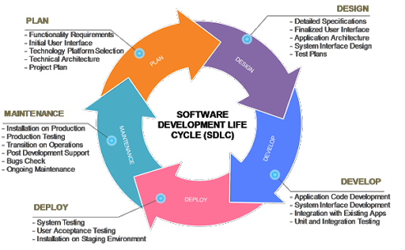
There are various stages in Software Development Life Cycle:

Slide 4
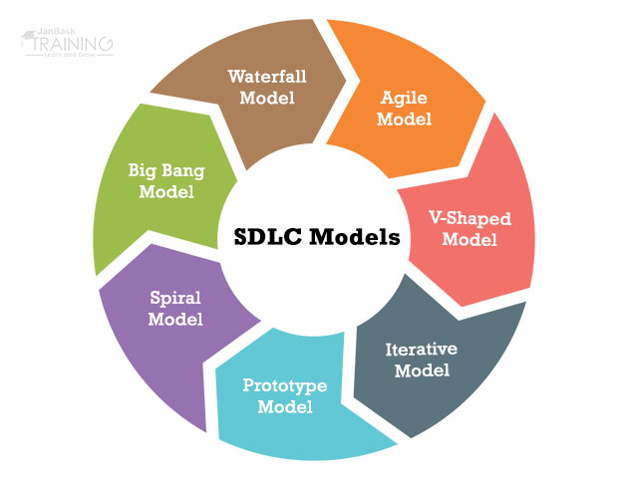
There are different types of models in SDLC

Slide 5
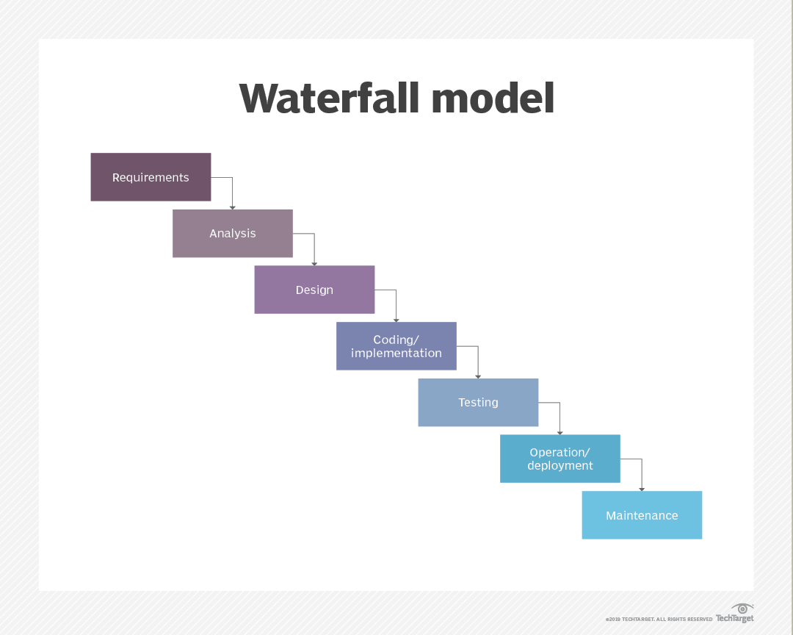
WATERFALL MODEL
The waterfall model is a breakdown of project activities into linear sequential phases, where each phase depends on the deliverables of the previous one and corresponds to a specialization of tasks.
The approach is typical for certain areas of engineering design.
In software development, it tends to be among the less iterative and flexible approaches, as progress flows in largely one direction ("downwards" like a waterfall) through the phases of conception, initiation, analysis, design, construction, testing, deployment and maintenance.

Slide 6
Advantages and Disadvantages of Waterfall model
Advantages
Disadvantages
It allows for departmentalization and managerial control.
Simple and easy to understand and use.
Easy to manage due to the rigidity of the model – each phase has specific deliverables and a review process.
Phases are processed and completed one at a time.
Works well for smaller projects where requirements are very well understood.
A schedule can be set with deadlines for each stage of development and a product can proceed through the development process like a car in a car-wash, and theoretically, be delivered on time.
It does not allow for much reflection or revision.
Once an application is in the testing stage, it is very difficult to go back and change something that was not well-thought out in the concept stage.
No working software is produced until late during the life cycle.
High amounts of risk and uncertainty.
Not a good model for complex and object-oriented projects.
Poor model for long and ongoing projects.
Not suitable for the projects where requirements are at a moderate to high risk of changing.

Slide 7
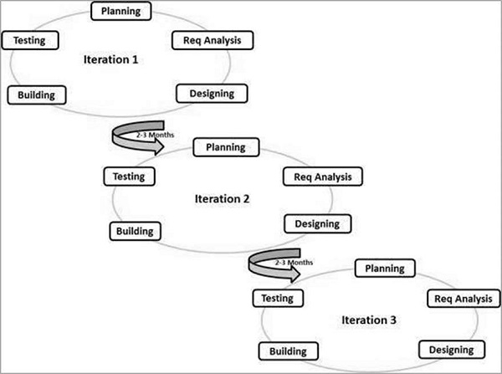
Agile Model
Agile SDLC model is a combination of iterative and incremental process models with focus on process adaptability and customer satisfaction by rapid delivery of working software product.
Agile Methods break the product into small incremental builds.
These builds are provided in iterations. Each iteration typically lasts from about one to three weeks.

Slide 8
Advantages and Disadvantages of Agile model
Advantages
Disadvantages
Is a very realistic approach to software development.
Promotes teamwork and cross training.
Functionality can be developed rapidly and demonstrated.
Resource requirements are minimum.
Suitable for fixed or changing requirements
Delivers early partial working solutions.
Good model for environments that change steadily.
Minimal rules, documentation easily employed.
Enables concurrent development and delivery within an overall planned context.
Little or no planning required.
Easy to manage.
Gives flexibility to developers.
Not suitable for handling complex dependencies.
More risk of sustainability, maintainability and extensibility.
An overall plan, an agile leader and agile PM practice is a must without which it will not work.
Strict delivery management dictates the scope, functionality to be delivered, and adjustments to meet the deadlines.
Depends heavily on customer interaction, so if customer is not clear, team can be driven in the wrong direction.
There is a very high individual dependency, since there is minimum documentation generated.
Transfer of technology to new team members may be quite challenging due to lack of documentation.

Slide 9
Difference between Waterfall model and Agile model
Waterfall Model
Agile Model
Feasibility evaluation takes a long phase and is done in advance to avoid reworking in the next project phases.
Project planning is done at the beginning of the project and is not open to any changes later on.
Progress gets monitored according to the plan
Only the project managers communicate and carry out progress review meeting weekly/monthly.
Roles are not interchangeable once distributed among team members.
Documentation gets a lot of emphases and that is pretty comprehensive.
Feasibility test takes a shorter while considerably.
The plan is not given the foremost priority and is done during sprint planning. Modifications are welcome except during an active sprint.
Development gets tailed in each sprint.
Communication is frequent, face-to-face, and clients also participate throughout the project.
You can switch roles quickly, and the team can work in cycles
There’s a need to file requirements, built designs, and write test plans to promote working software delivery.

